Slide 1
Gen Z Career Aspirations: Insights to Shape Tomorrow’s Workforce
Presented By- Aditi Agrawal
Date- 2nd May 2025

Slide 2



Agenda
Project Overview
Methodology Used
Key KPIs
Insights
Actionable Insights for Employers
Summary & Recommendations

Slide 3

Project Overview
Objective: To understand Gen Z’s career motivations and help organizations align better with their expectations.
Data Source: Response to Google Form by KultureHire
Participants: 500+ responses from multiple PIN codes
Notes:
Our goal was to decode the mindset of Gen Z—what drives their career choices, their work environment preferences, and how values, salary, and stability affect their employment decisions.

Slide 4

Methodology Used
Tools: Excel, SQL, Power BI
Filters Used: Gender, State, Salary Ranges
Steps:
Documenting the Problem Statement
Data Collection using Google forms
Data cleaning and standardisation using Excel
Data Analysis in SQL and Excel
Excel Dashboard Design
Power BI Dashboard Design
Notes:
We cleaned, transformed, and imported Excel data into SQL, conducted EDA to extract trends, and then visualized actionable metrics using interactive dashboards in Power BI and Excel

Slide 5
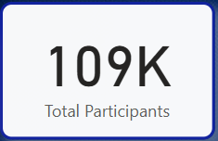
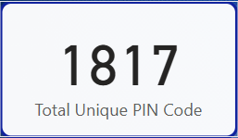
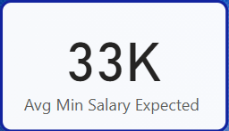
Key KPIs
This wide representation helps ensure that the insights are geographically and demographically meaningful.
Notes:
This wide representation helps ensure that the insights are geographically and demographically meaningful.

Slide 6
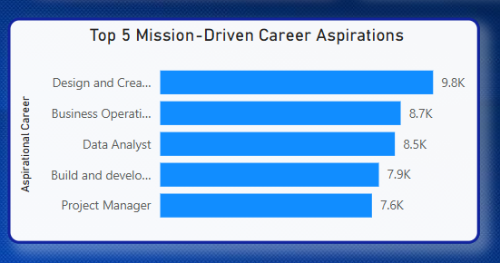
Gen Z Mission Aspirations
Gen Z is not one-dimensional; they seek both creativity and analytical depth in careers that align with their values.
There’s a clear mission-driven mindset, focusing on roles that create visible outcomes (design, development, project leadership)
Notes:
"Gen Z is highly mission-driven—more inclined towards careers that contribute to innovation, sustainability, and social good, rather than purely commercial goals."

Slide 7
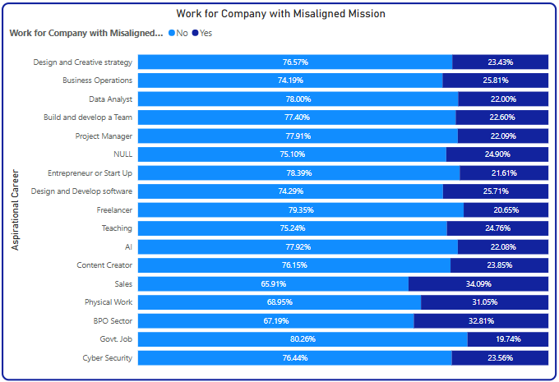
Mission Alignment
Insights
Highest willingness to compromise on mission alignment is seen in Sales (34.09%)
Lowest willingness to compromise observed in Freelancer (20.65%)
Strategic and innovation-driven careers (e.g., AI, Design Strategy) show stronger preference for purpose alignment.
Notes:
This indicates a significant shift from traditional financial motivation to a purpose-aligned professional identity.

Slide 8

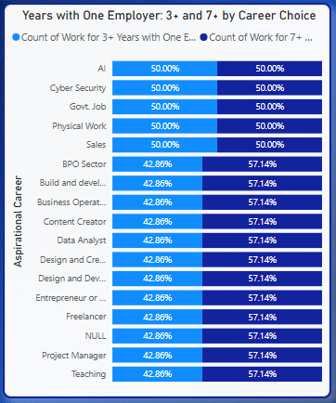
Managerial Expectations
Gen Z shows a pattern of “loyalty post-alignment.” They are more likely to explore options early on but will stay long-term when they find a purposeful role or work culture that resonates with their values.
Creative and analytical fields, though aspirational, might face higher early churn without structured growth pathways.
Notes:
Retention improves significantly when Gen Z sees leadership as ethical, empathetic, and enabling. Abusive or unclear leadership drastically reduces loyalty.

Slide 9
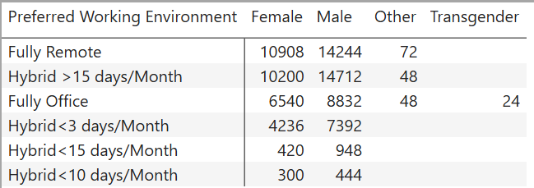
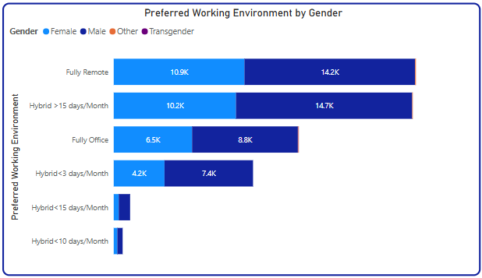
Work Setup Preferences
Flexibility is no longer a perk — it's a baseline expectation.
Fully remote and frequent hybrid models (15+ days/month) dominate as the most gender-inclusive and widely favored working setups.
Gen Z across all genders resists rigid office environments and expects autonomy in choosing workspaces.
Notes:
Remote work isn’t a privilege anymore—it’s a baseline expectation, especially among women respondents. Organizations must adjust their hybrid policies.

Slide 10
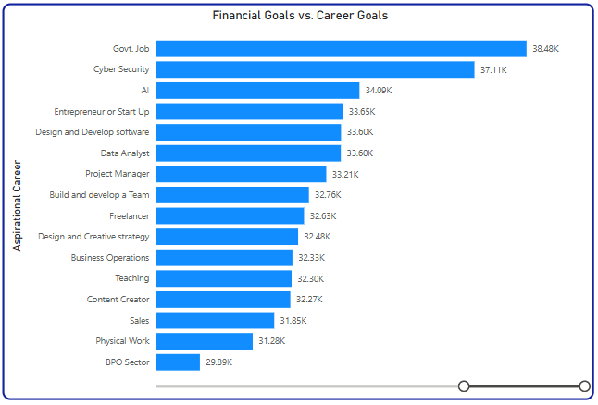
Financial Goals vs. Career Goals
Gen Z connects financial success most strongly with stable, scalable, or tech-forward careers like Government Jobs, Cybersecurity, and AI.
Creative, educational, and operational fields attract fewer respondents focused solely on financial goals, hinting at intrinsic motivation in these sectors.
Financial aspiration is a strong decision-making factor, especially for tech and government roles.
Notes:
While social sector aspirants are more mission-aligned, tech and business students still place salary first—offering a dual strategy is key

Slide 11
Actionable Insights for Employers
Design Purpose-Aligned, Flexible Talent Pipelines Offer clear career paths that blend ownership, creativity, and mission alignment while promoting hybrid or remote-first models based on role and gender insights.
Enhance Employer Branding with Impact, Flexibility & Growth Showcase stories of young professionals driving innovation, highlight flexible work options, and communicate how roles contribute to long-term impact and personal growth.
Personalize Retention & Career Strategies Using Data Track retention by career intent, and use career personas to tailor onboarding, mentorship, and financial literacy efforts.
Notes:
To attract and retain Gen Z, it's not just about perks—it’s about building purpose, people-first leadership, and trust.

Slide 12
Summary & Recommendations
Purpose-Driven Culture > Perks
Flexibility & Mental Health Support = Loyalty
Communication & Transparency = Trust
Notes:
Gen Z wants to be heard, valued, and aligned. Let’s build organizations where work means more than just work.

Slide 13
Thank you
Aditi Agrawal
Mail to- aditiag7017@gmail.com

